Slide 1
Create Mobile Application for IoT Devices Made Adi Paramartha Putra STMIK Primakara - 2020

Slide 2
Today Outline
Google Assistant for IoT
Create an automation using google assistant to control our Internet of Things devices
Android Studio for IoT Devices
Creating our own mobile application to control our IoT devices with simple based on android

Slide 3
Google Assistant for IoT
1
Control your IoT device with your command

Slide 4

Google Assistant Control

Slide 5
Adafruit
Simply in IoT sectors, Adafruit produced many sensor and other electrical component to crate an IoT devices.
Support Raspberry
Support Arduino
Sensors, 3D Printing, etc.

Slide 6
Adafruit - 2
Not only the devices, Adafruit provide us full service IoT integration.
Complete Library for all device
Integrated Database Control
Capability to connect with Google Assistant

Slide 7

Blynk
Differ with Adafruit, Blynk providing easy and fast access to controlling your IoT devices through your phone with many customizable control mode.
Support Raspberry
Support Arduino
Mobile Application Control

Slide 8
Blynk - 2
Blynk didn’t create the hardware, their company services is providing the software to control IoT devices through mobile phone
Download Blynk Apps
Download and Install Blynk Library
Create a Project to control IoT devices

Slide 9

IFTTT
IF This Then That (IFTTT) is a freeware web-based service that creates chains of simple conditional statements, called applets.
Support Adafruit
Support Blynk (via Webhooks)
Support many other services

Slide 10
IFTTT for Google Assistant
Adafruit
If we control our IoT device using Adafruit, quite simple and easy to use.
We must use the Adafruit Database
Blynk
Differ with Adafruit, Blynk integration with Google Assistant is very simple
We must declare the PinOut correctly

Slide 11
Connect Blynk with Google Assistant
LET’S Focus on This

Slide 12
How to Connect our IoT device
Install Blynk
Install your Blynk mobile application and crate a project to control relay with Google Assistant.
Install Library
Install the Blynk library in Arduino IDE, fill the auth token and SSID information.
Create IFTTT applets
Open ifttt.com, login and create a new applets based on Google Assistant and Webhooks (Blynk)

Slide 13
Let’s S t a r t to Crate our First IoT Integration

Slide 14
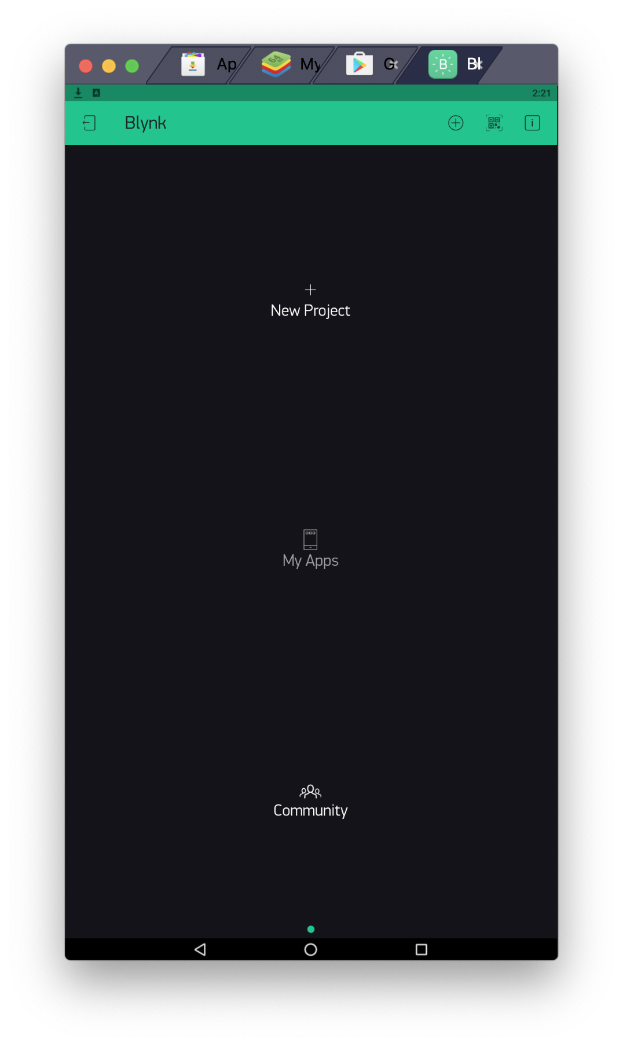
Create Project
Create a Blynk Project

Slide 15
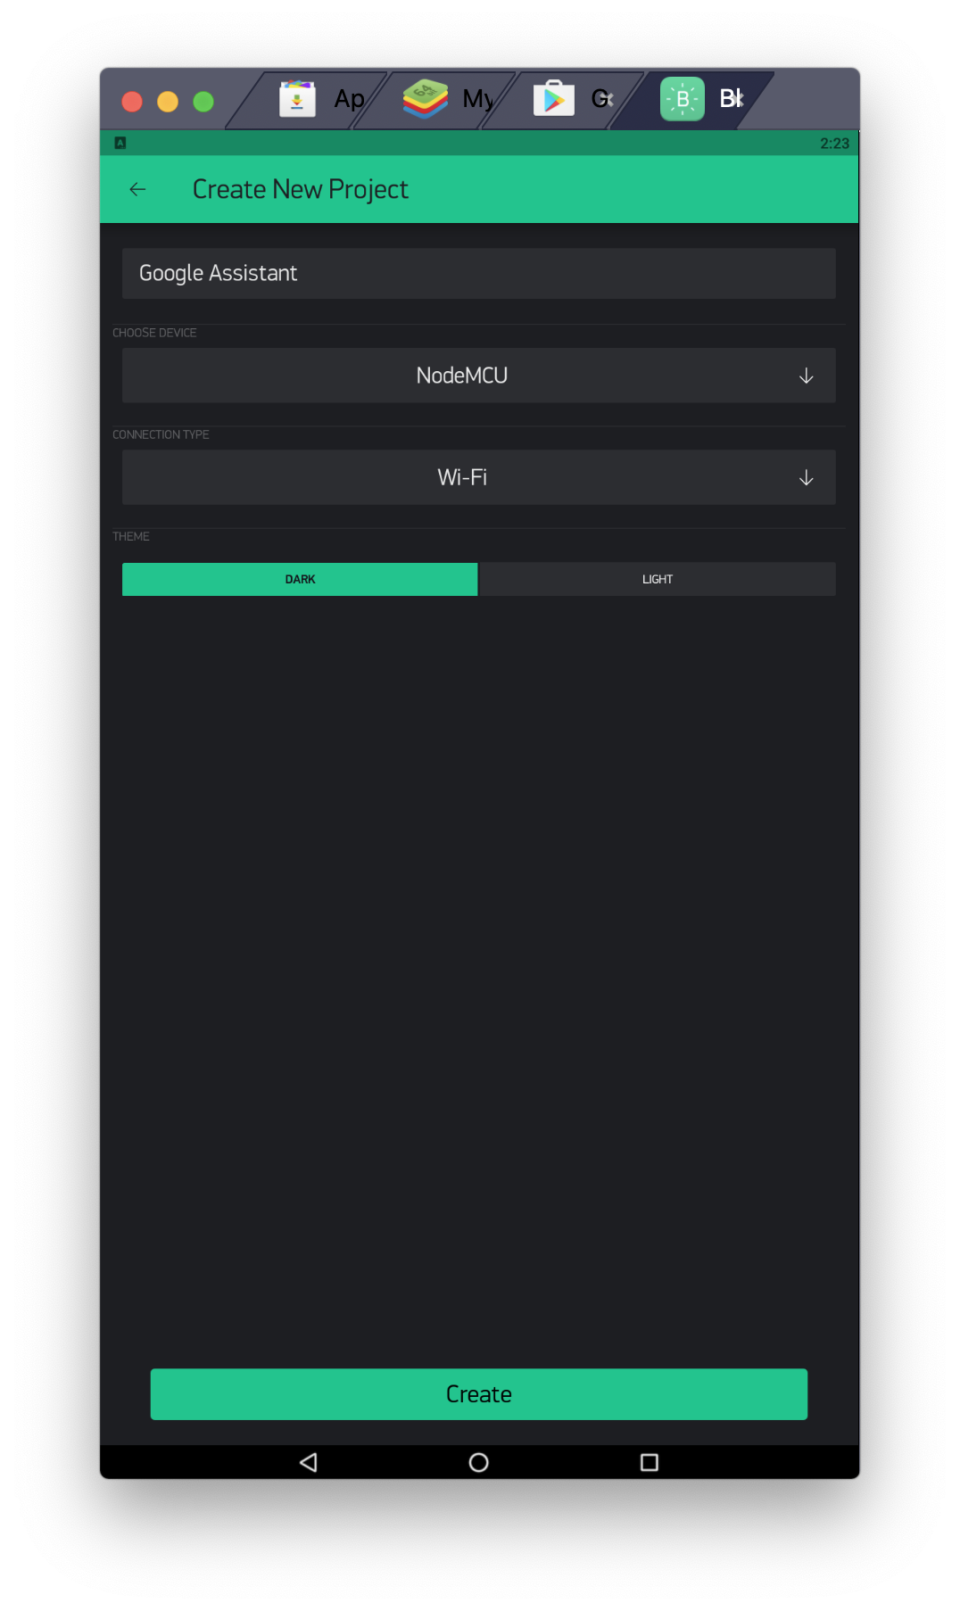
Create Project - 2
Specify the Project details

Slide 16
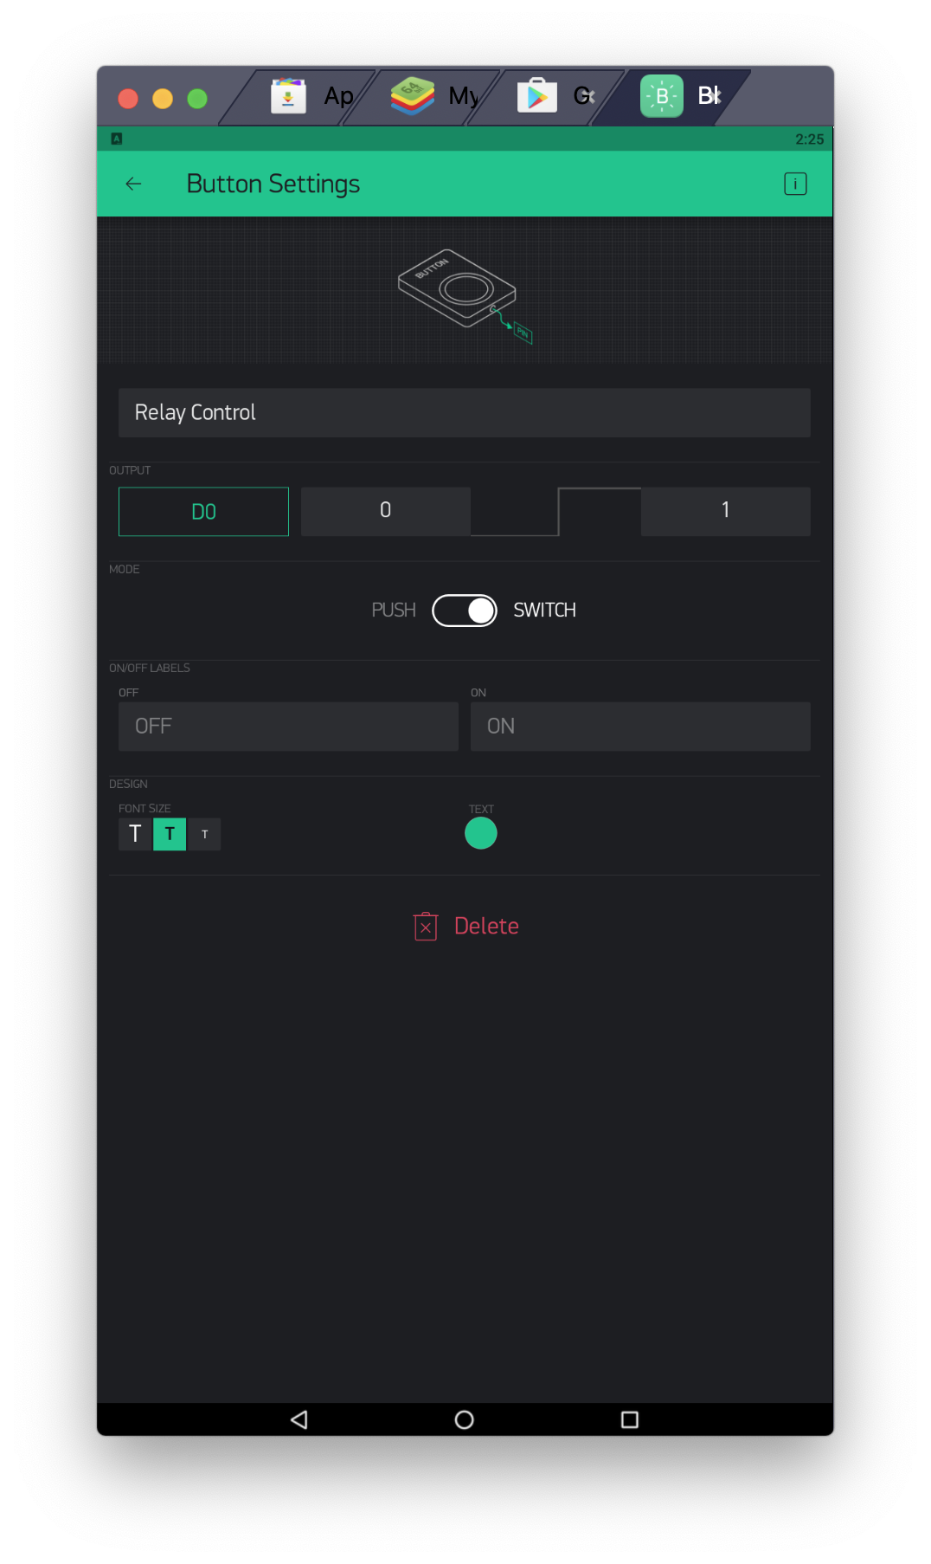
Create Project - 3
Add a button widget
Setting the button widget

Slide 17
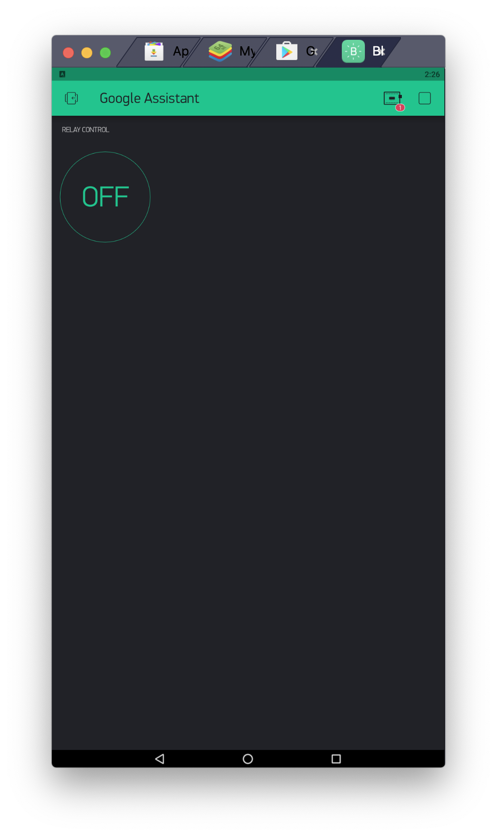
Create Project - 4
Start the Blynk Project

Slide 18
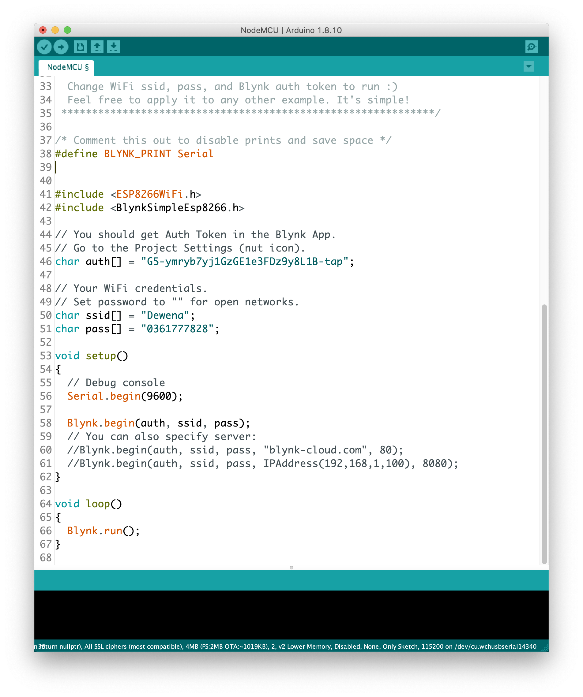
Create Project - 5
Modify the Arduino Code (based on Blynk library)
Auth token (check email) and SSID Information
Upload the code. Remember the board and port information

Slide 19
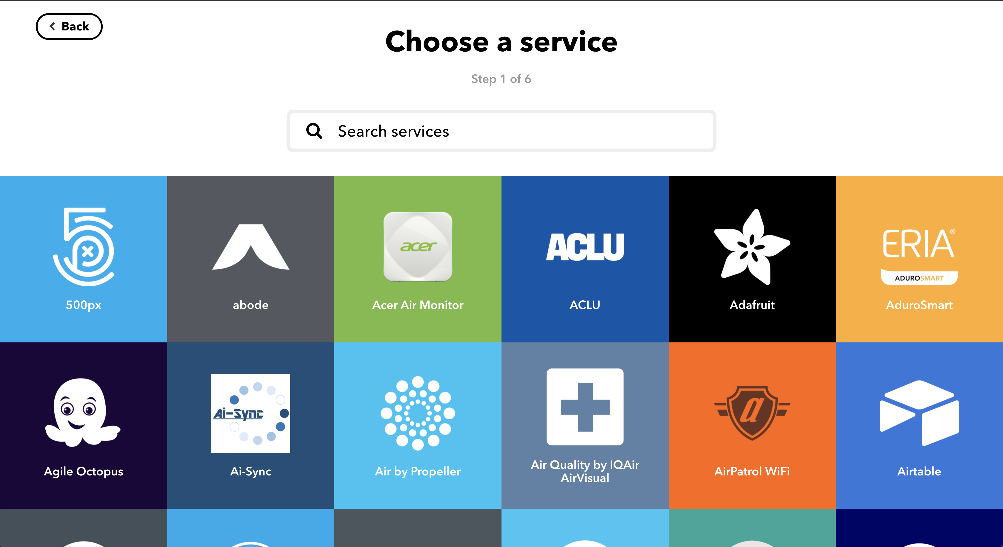
Create Project - 6
Open ifttt.com
Create an IFTTT Applets
Specify the Google Assistant voice command and Webhooks for Blynk

Slide 20
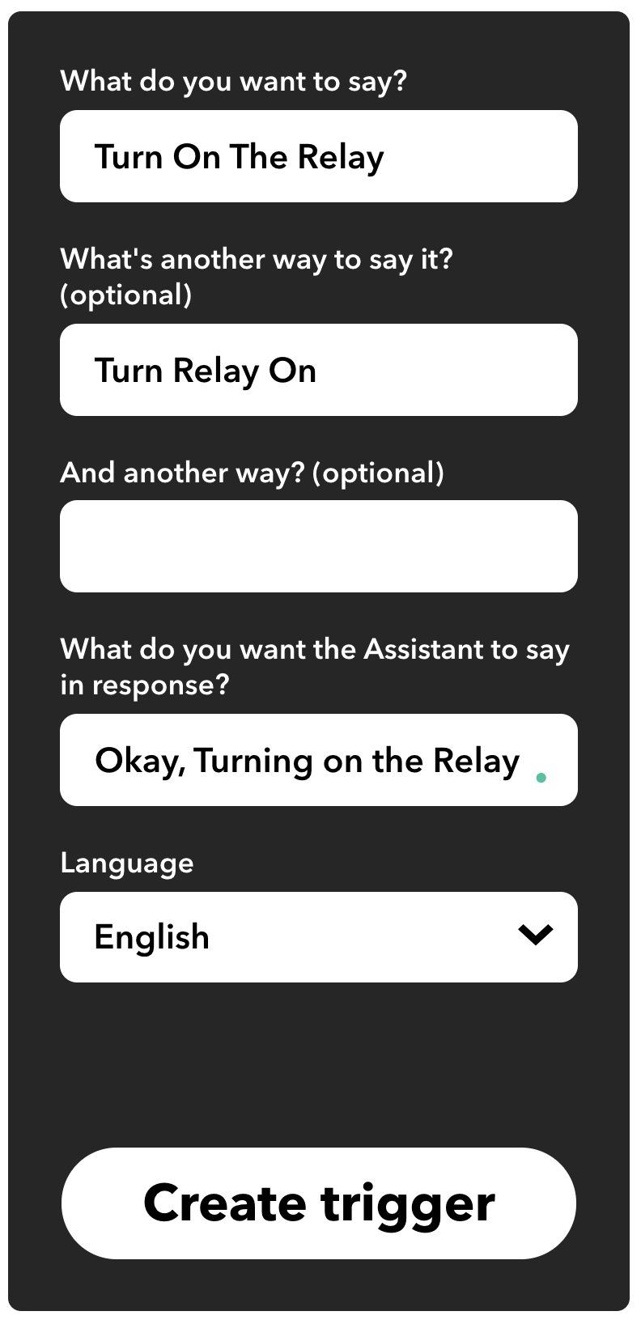
Create Project - 7
Add Simple Phrase
Specify the voice command to do something
As well as the respond from Google

Slide 21
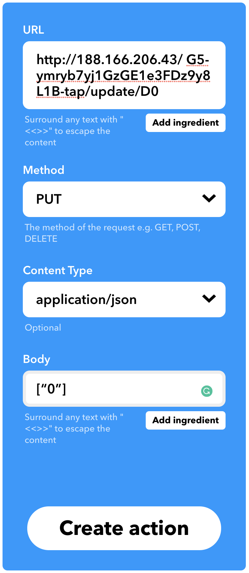
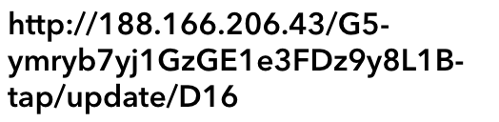
Create Project - 8
http://ip of blynk-cloud/auth token/update/digital pin
http://188.166.206.43/G5-ymryb7yj1GzGE1e3FDz9y8L1B-tap/update/D16
Method: PUT
Content: application/json
Body: [“0”] (0 / 1 )

Slide 22
Things you should remember

Slide 23
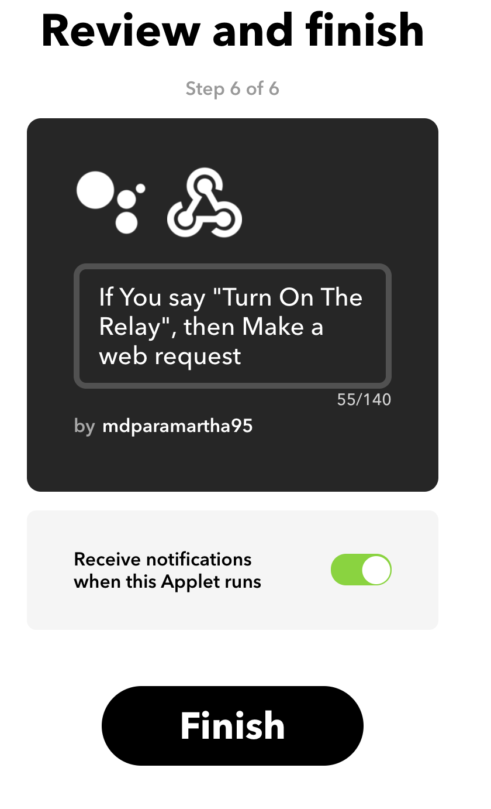
Create Project - 9
Review the applets
Done

Slide 24
Create Project - 10
Use Google Assistant on your phone to Turn On the relay

Slide 25
Let’s Test It!
Check this out!

Slide 26
Oh That Just Turn On
Let’s create the turn off function

Slide 27
Create Project - 11
Create another IFTTT Applets
Again, Specify the Google Assistant voice command and Webhooks for Blynk

Slide 28


Create Project - 12
Add Simple Phrase to Turn Off
Specify the voice command to do something
As well as the respond from Google

Slide 29
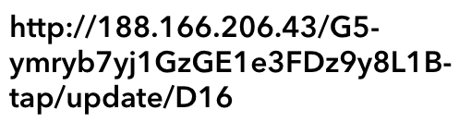
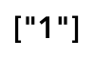
Create Project - 13
http://ip of blynk-cloud/auth token/update/digital pin
http://188.166.206.43/G5-ymryb7yj1GzGE1e3FDz9y8L1B-tap/update/D16
Method: PUT
Content: application/json
Body: [“1”] (0 / 1 )

Slide 30
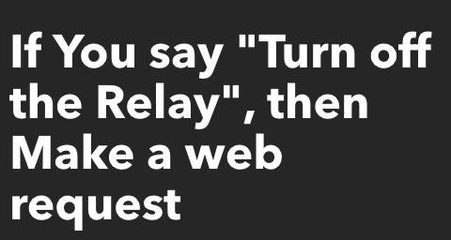
Create Project - 14
Review the applets
Done

Slide 31
Create Project - 15
Use Google Assistant on your phone to Turn Off the relay

Slide 32
Let’s Test It! (AGAIN)
Check this out!

Slide 33
Android Studio for IoT Devices
2
Create simple app with android studio

Slide 34
Android Studio Logo

Slide 35
Android Studio
Android Studio is Android's official IDE. It is purpose built for Android to accelerate your development and help you build the highest-quality apps for every Android device.
Android Studio offer tools custom-tailored for Android developers, including rich code editing, debugging, testing, and profiling tools.

Slide 36
How to Create Mobile Apps for IoT
Android Studio support the Firebase Realtime database inside its IDE.
Using that feature, we able to create a simple mobile apps that connected to Firebase database easily

Slide 37
Mobile Apps for IoT Overview
Install and open the Android Studio.
Update to current version of Android Studio
Make sure your firebase database already set.
Create a new empty activity in Android Studio
Copy google service JSON
Connect the application based on firebase database assistant
Create a button to control relay
Crate text view to shows current temp and humidity

Slide 38
Full Step-by-Step
Let’s Create it now!

Slide 39
Step-by-Step Application
Create New Empty Activity in Android Studio
Download Google Service JSON File (From Firebase Console)
Connect with Firebase Database Assistant (Dependencies)
Add Button to Turn On and Off Relay
Get Firebase Database (Read Current Relay Condition)
Set New Value if Button was Clicked
Run the Apps

Slide 40
Adding TextView
For DHT Sensor Value

Slide 41
DHT Sensor Value
Add Text View for Temperature and Humidity
Get Firebase Data (Temp & Hum)
Run the Application

Slide 42
Modify
Of course you able to modify the mobile apps by your self

Slide 43
Users point of view
Mobile Apps
Users able to control their IoT devices through their phone, and they spend most of their time on the application.
1
Database Connection
Users able to see the Database connection from their IoT devices and the Mobile Apps. This condition just occurs few times.
2
IoT Devices
Users devices is configured from the start with specific Pinout, and normally this just happened once at the beginning of the project
3

Slide 44

Thanks!
Any questions?
You can find me at:
@adiparamartha
adi@primakara.ac.id

Slide 45
Credits
Special thanks to all the people who made and released these awesome resources for free:
Presentation template by SlidesCarnival
Photographs by Unsplash

